Slide 1



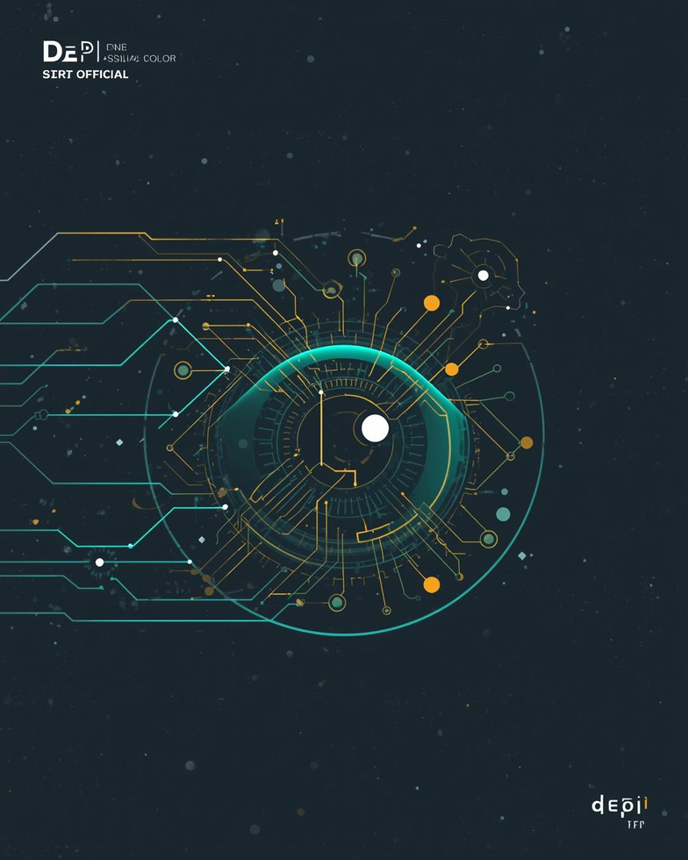

Your-EYES
(Intelligent Vision System)
Presented by :
Abdelrahman gabr - Fatema Elzhraa - mohamed sadek Mahmoud Askar - Shahd Ahmed - Nancy Ahmed
10/14/24
1

Slide 2
Project Idea
Addressing visual impairment challenges
Core Problem
Innovative Solution
Unique Value
Many individuals with visual impairments struggle with real-time object recognition, leading to increased dependency on others and challenges in navigating their environments independently and safely.
Our AI-based & ML system provides real-time object detection and audio guidance, empowering users to identify objects around them, enhancing their ability to move confidently and independently in various settings.
This technology offers a unique value proposition by combining accurate detection with audio feedback, significantly improving the user experience and ensuring a higher level of independence for visually impaired individuals.
10/14/24
2

Slide 3
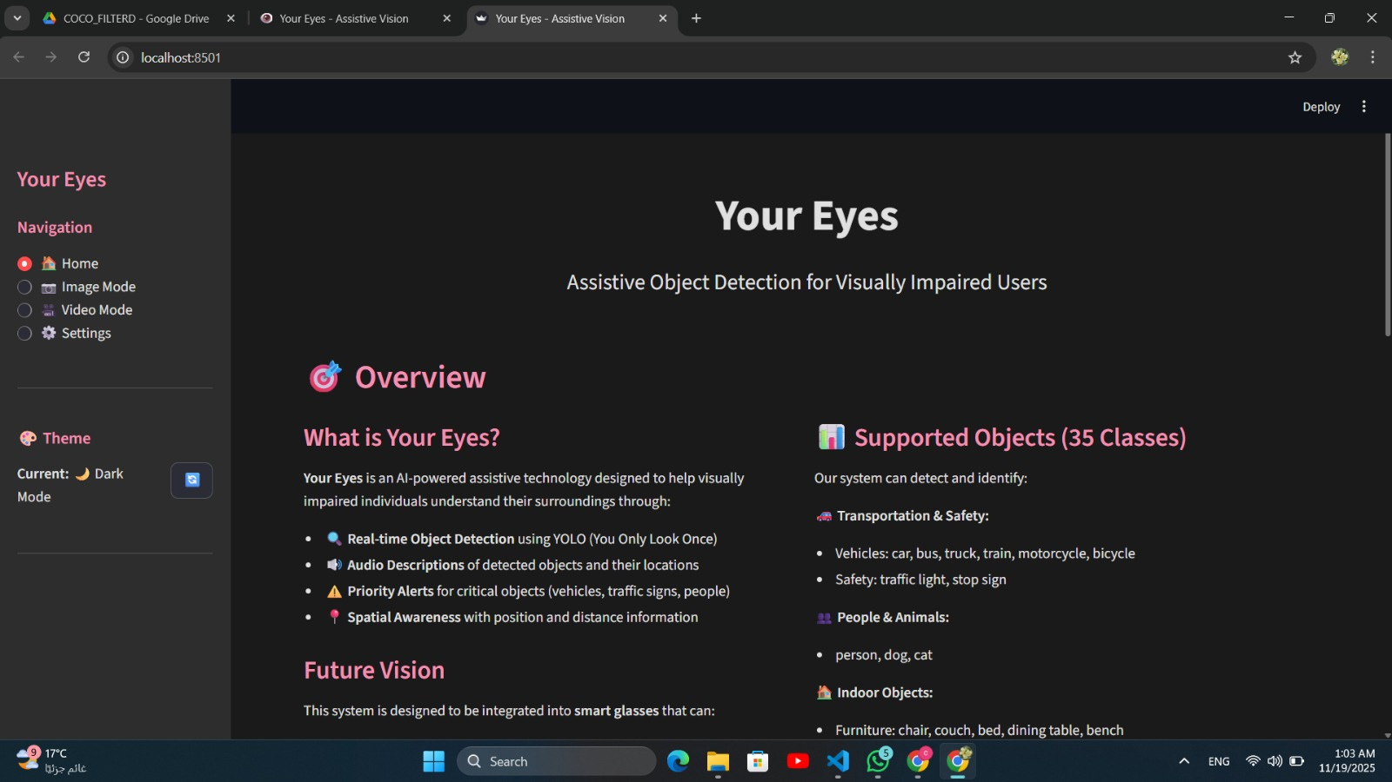
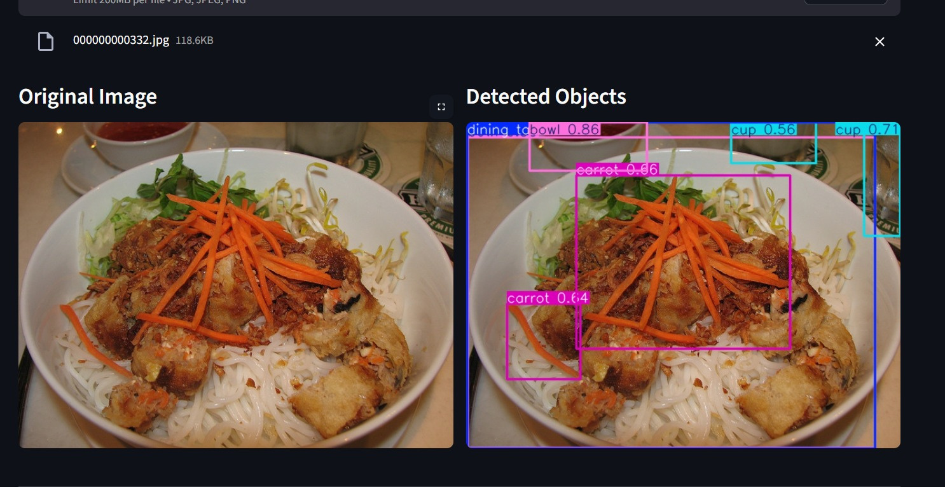
User Interface Wireframe Overview
Visualizing user journey and interaction
This section highlights the key elements of the application's user interface, showcasing intuitive design that facilitates efficient interaction and enhances the overall user experience.
3
10/14/24
3

Slide 4


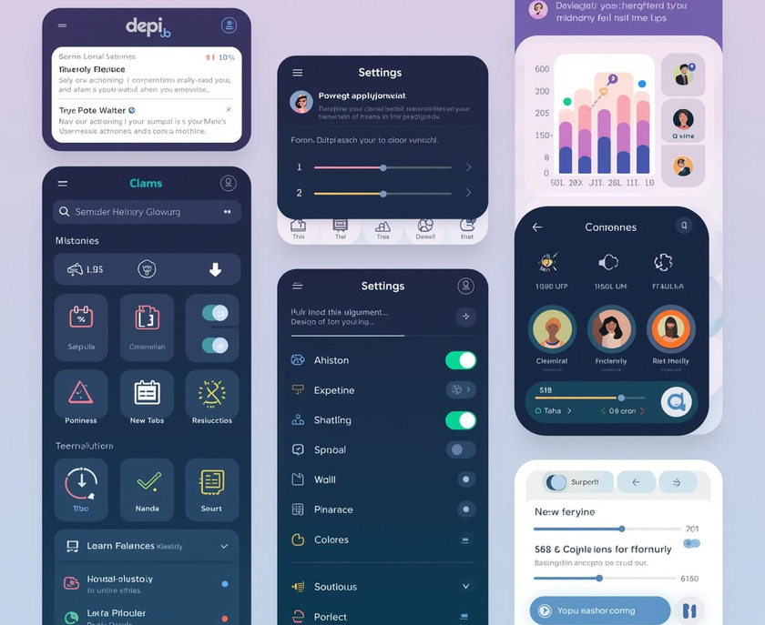
End Users and Key Features
Visually Impaired
Elderly Users
Caregivers
Individuals
Seniors
Customization
Designed to assist visually impaired individuals effectively.
Tailored for elderly users to enhance independence.
Offers customizable settings for user preferences.
10/14/24
4

Slide 5
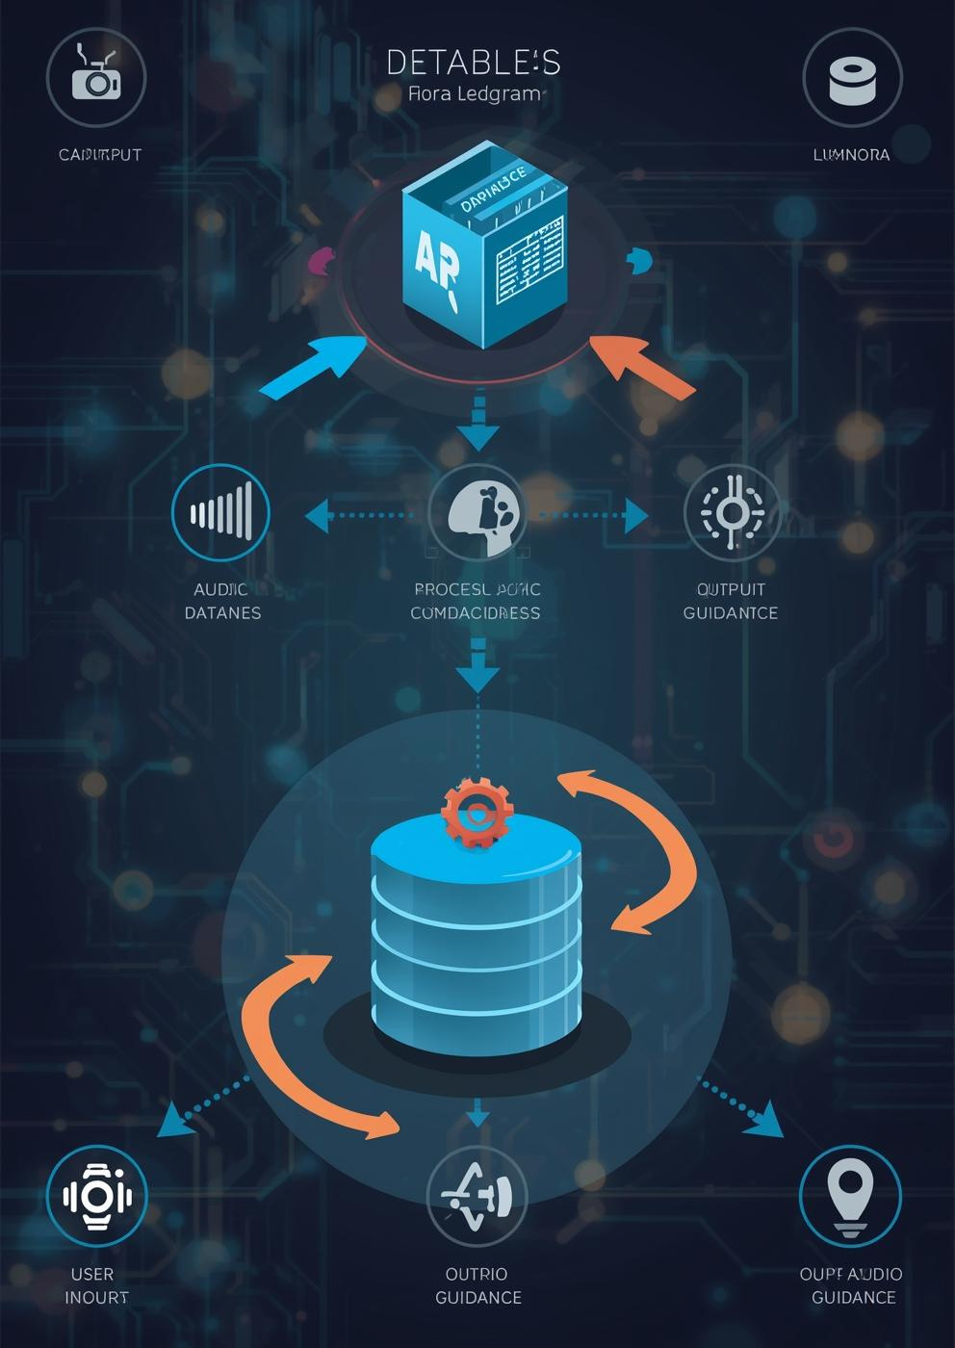
Data Structure(Dataset overview)
Overview of database architecture, entities, and data flow management for the system
We used the COCO2017 Dataset as the raw data (Images + JSON annotations).
We selected only 35 classes out of the original 80 to reduce training time, dataset size, and improve model quality.
We preserved the original image IDs and dimensions with no modifications.
We converted the annotations from COCO JSON → YOLO format, generating one TXT label file for each image.
10/14/24
5

Slide 6
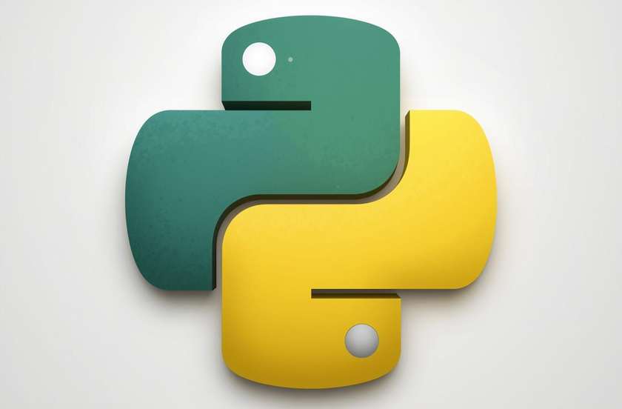
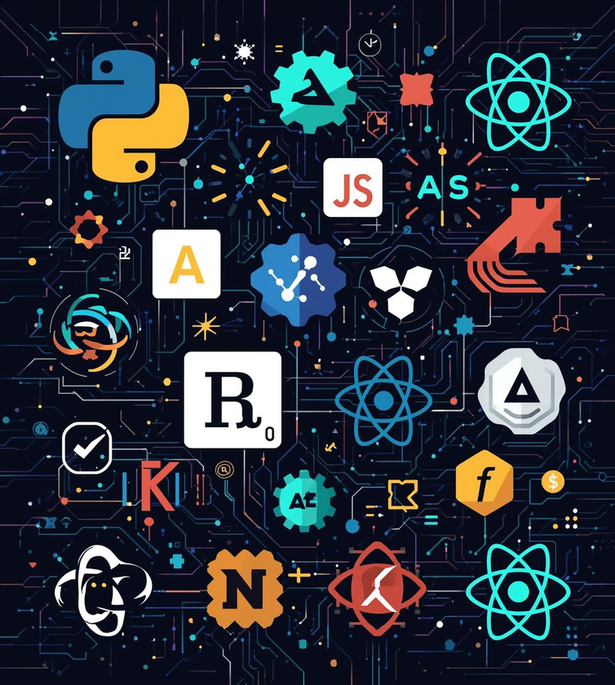
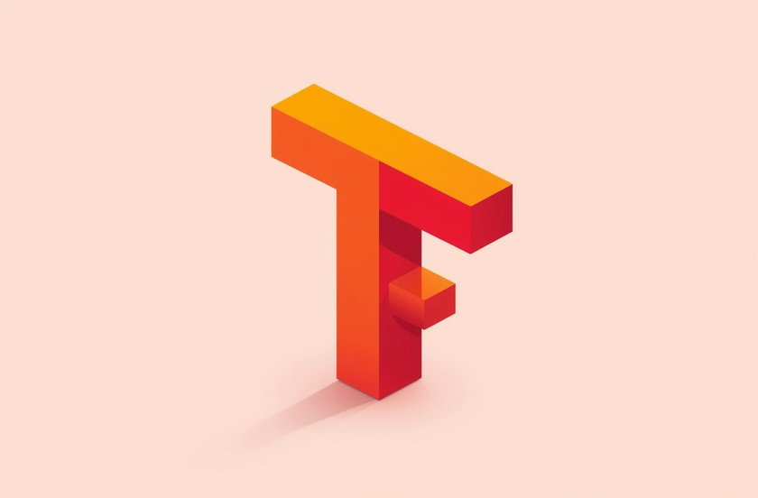
Programming Languages + Frameworks Languages :
Languages:
Python 3.11(Core development)
Frameworks & Tools:
YOLOv11 (Ultralytics)
Streamlit (GUI frontend)
OpenCV (video/image processing)
PyTorch (deep learning backend)
+Extra features
10/14/24
6

Slide 7
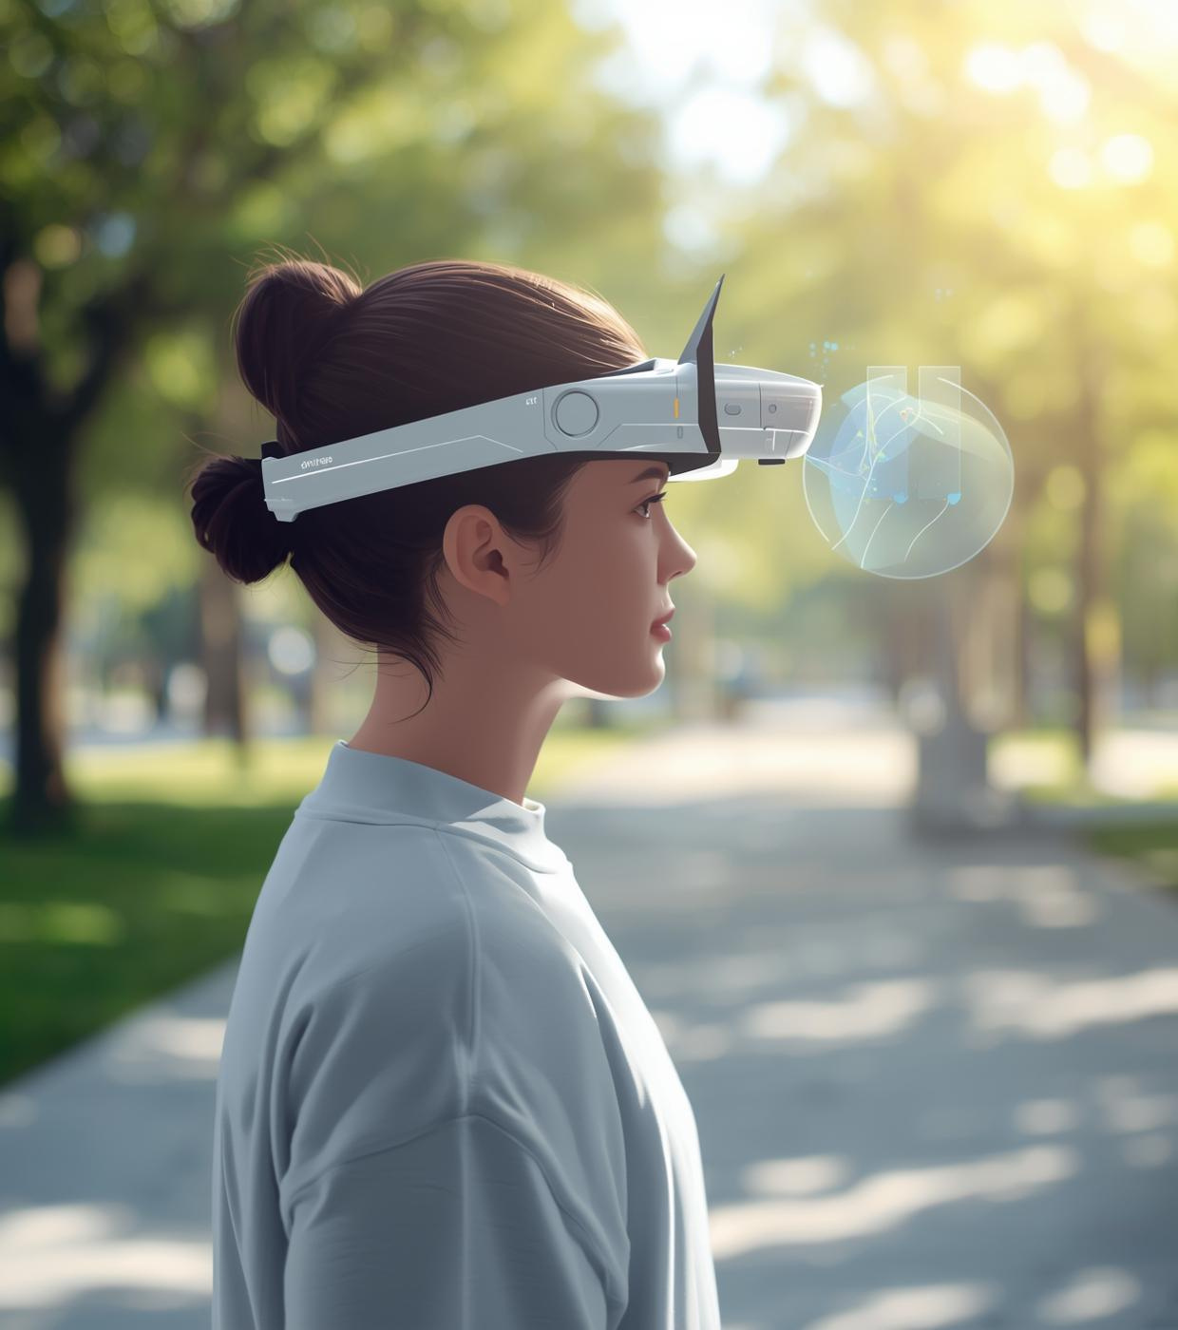
Current Application Status
Overview of Deployment, user feedback, and system performance improvements(specifically Model accuracy).
Conducted unit and integration testing.(Done)
Positive user feedback on audio guidance features(Done)
Improvements made based on usability testing results(Doing)
10/14/24
7

Slide 8

Project Deliverables
Overview of reports, timelines, and final products developed for the system
Technical documentation
Source code repository
Working Website
Web-Cam
Training materials
Team Presentation
10/14/24
8

Slide 9
Project Deliverables(Pipeline Arch.)
Data Collection, Pre-processing, and Analysis
Advanced Techniques, Transfer Learning
Image/Video Classification and Object Detection Model Development
MLOps, Monitoring, and Web Interface
10/14/24
9

Slide 10

Team Composition
Roles and responsibilities of our dedicated project team members
...(will be added after finishing the last phase)
Collaboration:
GitHub version control
Agile weekly sprint updates
Shared issue tracking
Notion
10/14/24
10

Slide 11
Thank You
Your questions and feedback are appreciated for improvement
10/14/24
11

